Slide 1
International NGO’s
Animal Charities
Health Charities
Different Types Of Charity.
Environmental Charities
Art & Culture Charities
Education Charities

Slide 2


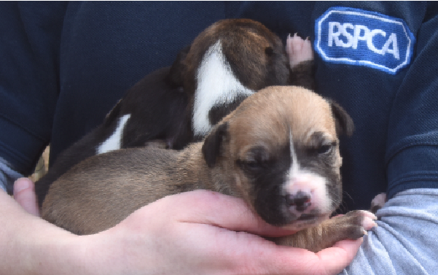

RSPCA – (Animal Charity)
Who we are:
We're the Royal Society for the Prevention of Cruelty to Animals (RSPCA) and we've been here, looking out for animals, since 1824.
It's our vision to live in a world where all animals are respected and treated with compassion.
Every day, with the help of our people and our generous supporters, we take steps to achieve our mission. From rescuing a stranded deer to changing the law, we've already achieved so much and come so far.
https://youtu.be/0bTd0PA4ABQ

Slide 3


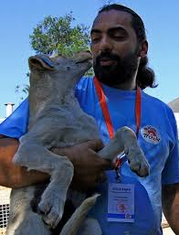
Four Paws - (Animal Charity)
OUR PAWS is an international animal welfare charity. Our vision is a world where humans treat animals with respect, empathy and understanding.
Our mission is to be the strong, global and independent voice for animals under human control.
Creating sustainable solutions for animals in need
Touching hearts, changing consumer behaviour
Driving legal changes
Building powerful partnerships
We aim to realize these goals through our projects and campaigns, which provide short-term and long-term solutions for animals in need.
https://youtu.be/5V2zStorQn0

Slide 4

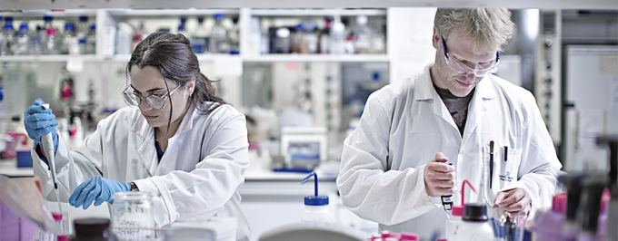
Cancer Research – (Health Research)
Who We Are:
Cancer affects people all over the world. To beat it, we need to work together.
Cancer Research UK is the largest independent funder of cancer research in the world. We support the best scientists, doctors and nurses to discover new ways to prevent, diagnose and treat cancer across the world. And we rely entirely on donations to make it happen.
Cancer affects people all over the world. To beat it, we need to work together.
Cancer Research UK is the largest independent funder of cancer research in the world. We support the best scientists, doctors and nurses to discover new ways to prevent, diagnose and treat cancer across the world. And we rely entirely on donations to make it happen.
We bring together the world's best scientists to tackle cancer.
We partner with organisations in every part of the world.
We develop cancer drugs and other treatments that are used world-wide.
We provide cancer information verified by doctors, nurses and other experts.
We fund research around the world, working across five continents

Slide 5


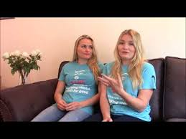
Sane – (Health Charity)
About SANE
SANE was established in 1986 to improve the quality of life for people affected by mental illness, following the overwhelming public response to a series of articles published in The Times entitled The Forgotten Illness.
SANE's vision has remained consistent throughout its history: to raise public awareness; excite research; and bring more effective professional treatment and compassionate care to everyone affected by mental illness.
SANE is a UK-wide charity working to improve quality of life for people affected by mental illness. SANE has three main objectives linked to our aims and outcomes:
To raise awareness and combat stigma about mental illness, educating and campaigning to improve mental health services.
To provide care and emotional support for people with mental health problems, their families and carers as well as information for other organisations and the public.
To initiate research into the causes and treatments of serious mental illness such as schizophrenia and depression and the psychological and social impact of mental illness.
SANE offers emotional support and information to anyone affected by mental health problems through our helpline, Text care and our online Support forum where people share their feelings and experiences.

